Slide 1
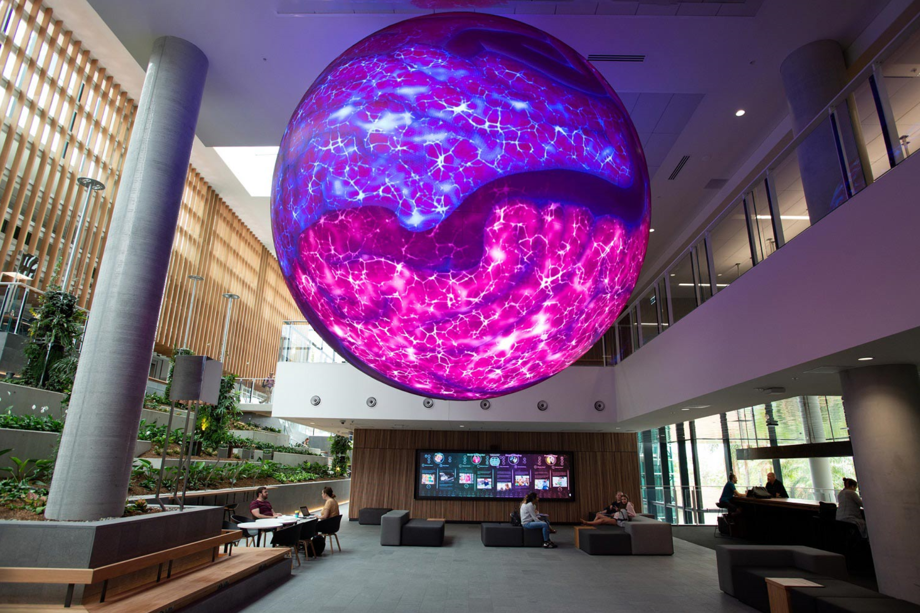
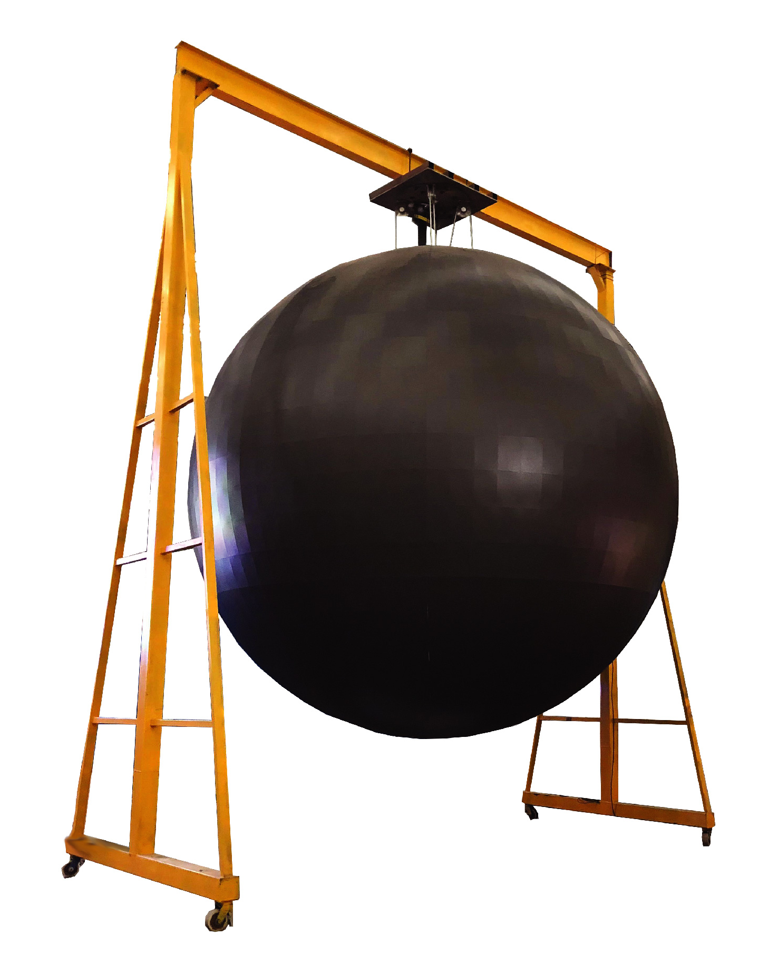
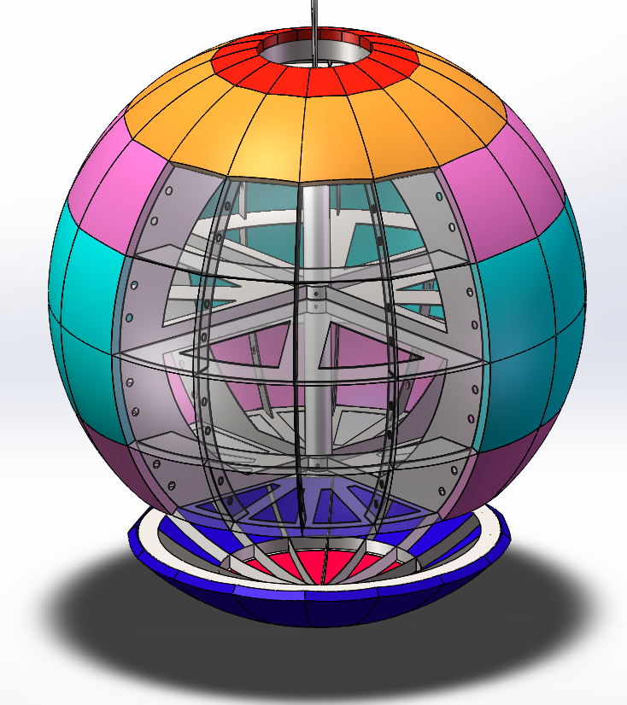
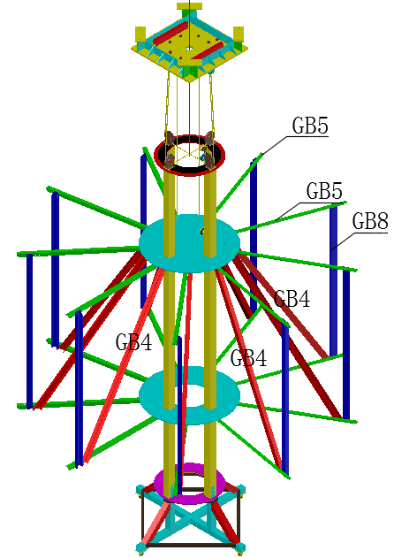
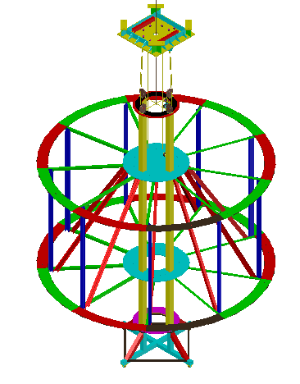
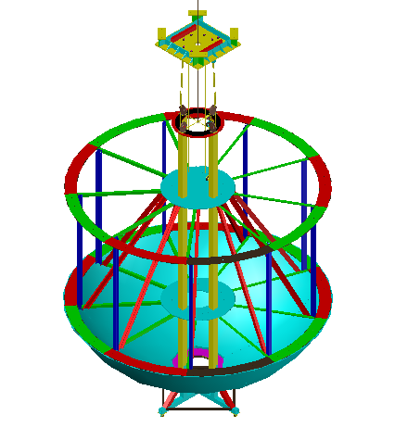
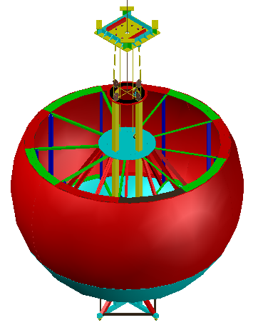
LS-SPHERE SERIES LED PANEL
LSIB1.8-φ3.2m LSIB2.5-φ2m LSIB2.5-φ2.5m LSIB3-φ1.8m LSIB3-φ2.5m LSIB3-φ5m
DESIGNED FOR COMMERCIAL OR ENTERTAINMENT VENUES
LS-Sphere series LED panels are customized
PRODUCT IMAGE
FEATURES
Different diameters are available
Customized mechanical system(Lifted up & down)is optional
Excellent flatness & seamless alignment
Dismountable cabinet and structure for easy transportation
STRUCTURE
Hanging or floor stand optional-Satisfy with multi-functional applications
Mechanical up & down optional-Safe for maintenance
Structure dismountable optional-Convenient for shipping
www.leyard-linso.com

Slide 2
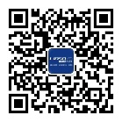
TECHNICAL PARAMETERS
Item | LSIB1.8-φ3.2m | LSIB2.5-φ2m | LSIB2.5-φ2.5m | LSIB3-φ1.8m | LSIB3-φ2.5m | LSIB3-φ5m
Diameter | 3.2m | 2m | 2.5m | 1.8m | 2.5m | 5m
LED size(㎡) | 32.153 | 12.56 | 19.625 | 10.173 | 19.625 | 78.5
Pixel Pitch（mm） | 1.875mm | 2mm | 2.5mm | 3mm | 3mm | 3mm
Encapsulation | SMD1515
Pixel density(dots/㎡) | 284089 | 250000 | 160000 | 111111 | 111111 | 111111
Brightness(cd/sqm) | 600~800cd/sqm
Viewing Angle | H:140°/V:120°
Module size(W*H)mm | Customize
Cabinet material | Iron
IP rating(F/R) | IP40/IP30
Gray scale | 14-16 bits
Contrast ratio | 5000:1
Color temperature | 3000~10000K
Refresh Rate (Hz) | 3840Hz
Working temperature(℃） | -10~40℃
Working humidity（%） | 10-80%
Working voltage(V) | AC110V-240V
Power consumption(W) | M：700W/㎡ A：235W/㎡ | M：700W/㎡ A：235W/㎡ | M：700W/㎡ A：235W/㎡ | M：700W/㎡ A：235W/㎡ | M：700W/㎡ A：235W/㎡ | M：700W/㎡ A：235W/㎡
Installation method | Hang/Floor stand
Mechanical system | Optional
CE certificate | Optional
Remark: Above data is subject to change without previous notice
Linso Culture & Technology (Shanghai) Co., Ltd
ADD:NO1259,Jiamei Road,Nanxiang Town,Jiading District,Shanghai,201802,China.
Tel:+86-21-69927037 Fax: +86-21-69927035
Email:sale@linso.com.cn
Website:www.leyard-linso.com

