Slide 1
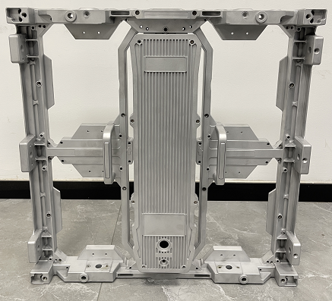
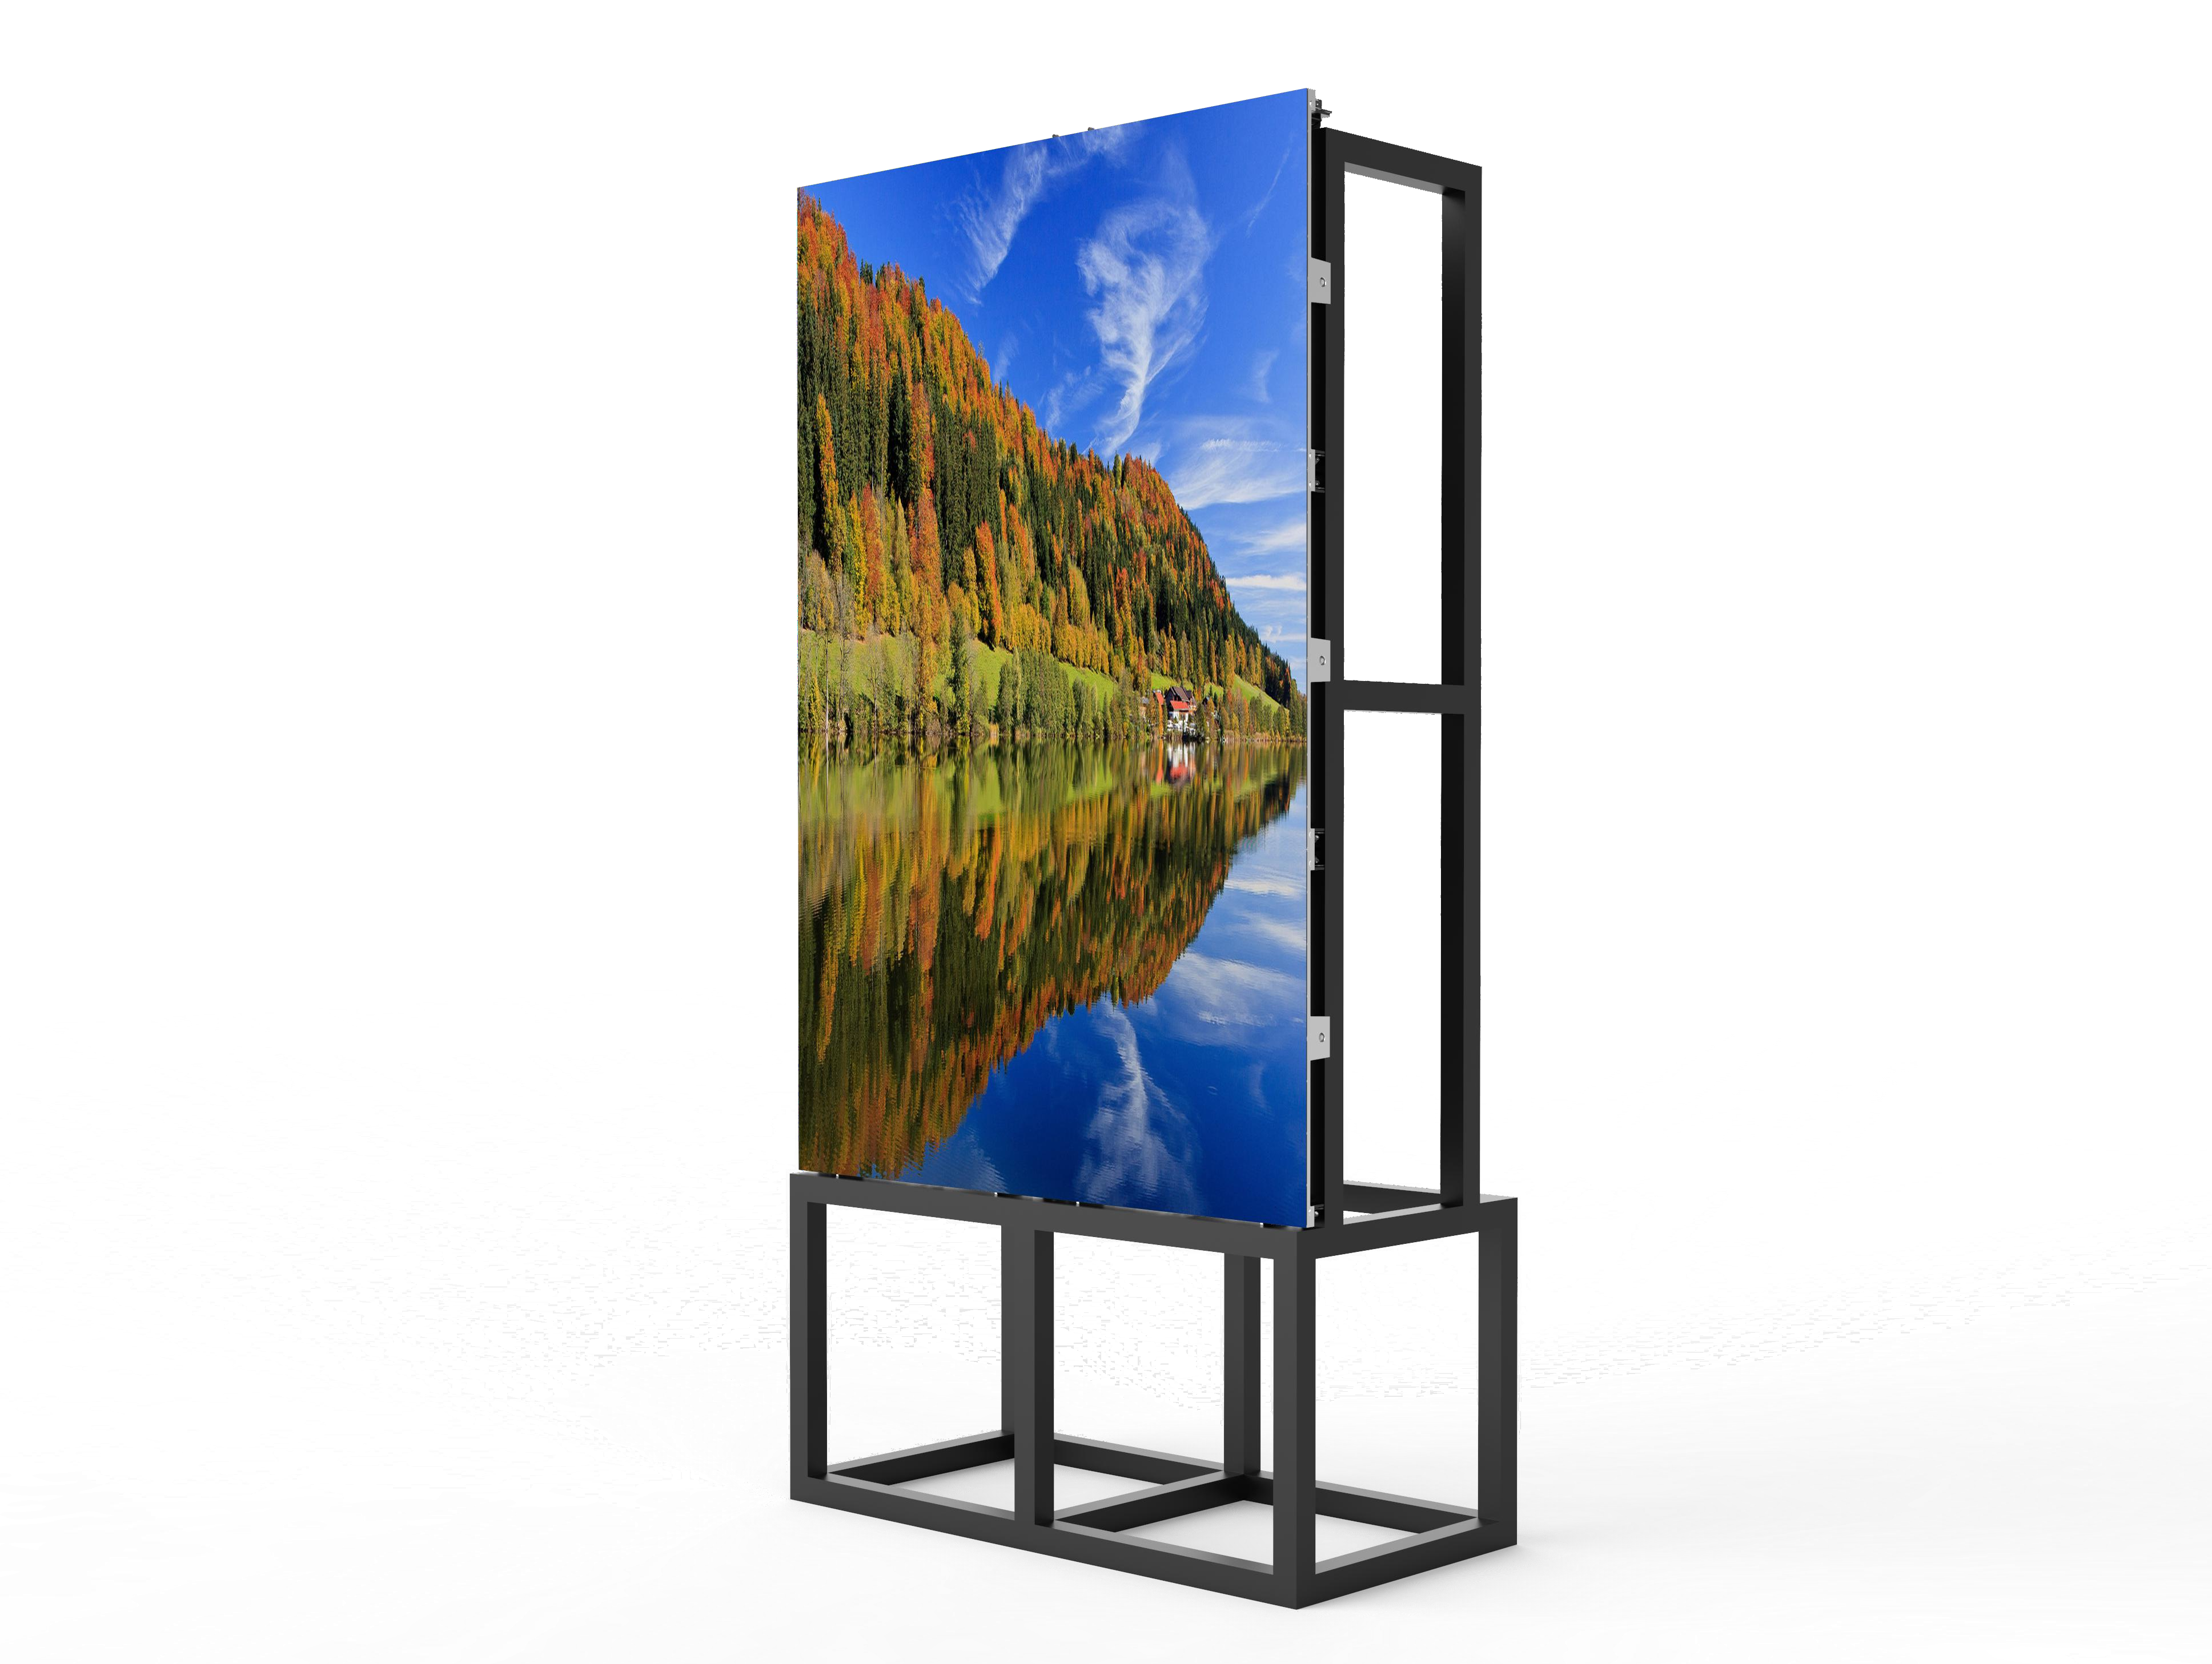
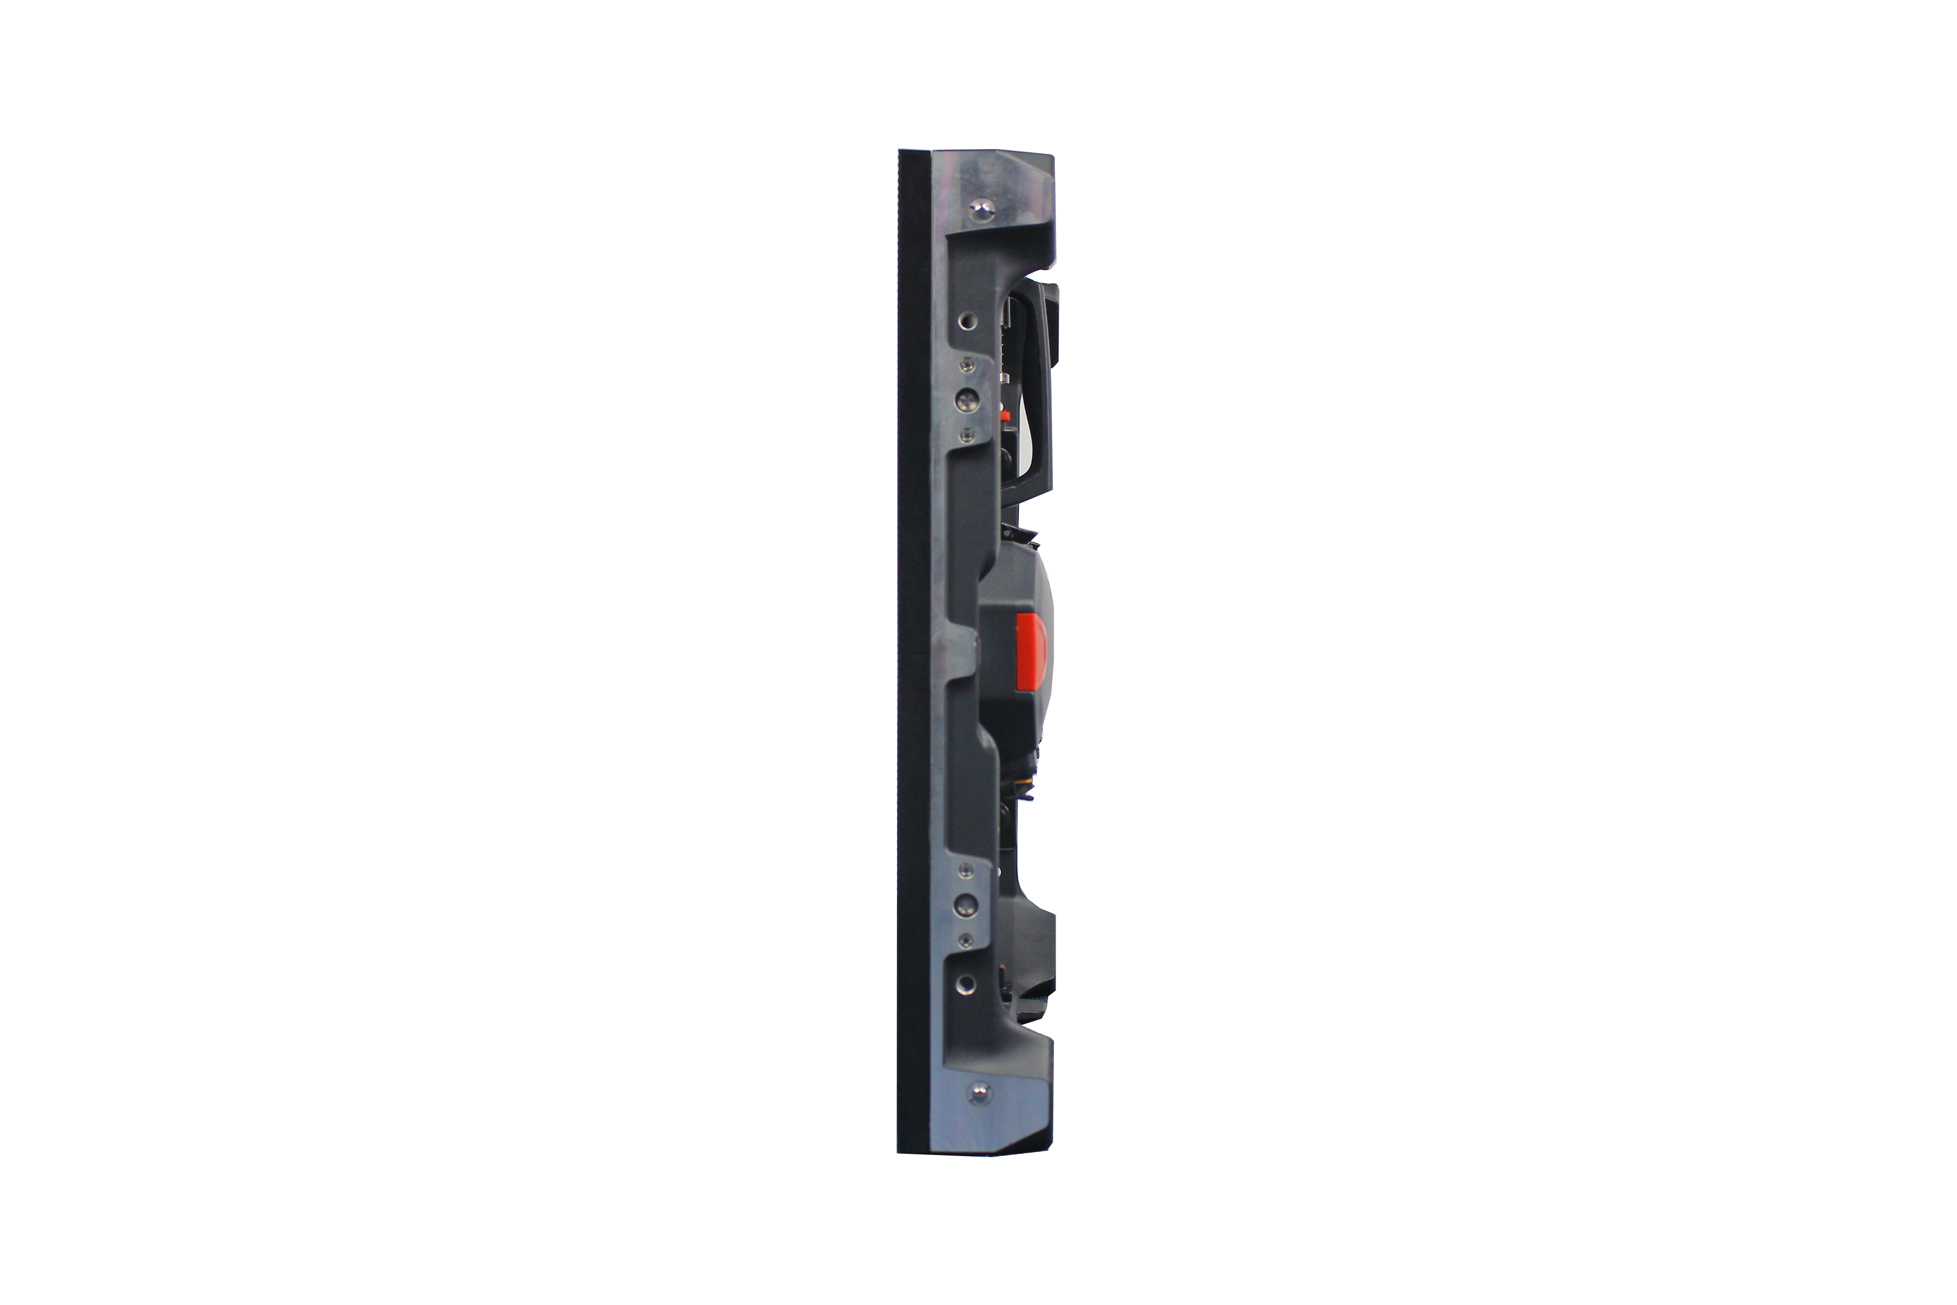
LSOF SERIES LED PANEL
LSOF156 LSOF195
DESIGNED FOR INDOOR/OUTDOOR FIXED APPLICATIONS
LSOF series LED panels are designed for indoor/outdoor fixed applications,support 100% front access
PRODUCT IMAGE
FEATURES
cabinet size 500x500mm
High brightness,high contrast ratio
High refresh rate, no ghosting
Excellent visual quality, seamless alignment
Magnetic front service,front installation
Anti fire / corrosion
High contrast ratio > 5000:1
Customized PCB design for more reliable
STRUCTURE
Ground Structure Installation
Wall mounted
Stage design
www.leyard-linso.com

Slide 2
TECHNICAL PARAMETERS
Model name | LSOF156 | LSOF195
Pixel Pitch (mm) | 1.56 | 1.953
Pixel Density (dot/m2) | 409600 | 262144
Cabinet resolution | 192*192 | 256*256
Cabinet Size (Wmm * Hmm* Dmm) | 500*500*80 | 500*500*80
Module Size (Wmm * Hmm*D) | 250*250*24.6 | 250*250*24.6
Module Resolution (PX* PX) | 160*160 | 128*128
Module Weight (kg) | 0.55 | 0.55
Drive Mode: | Constant Current | Constant Current
Horizontal Viewing Angle (Deg) | 160 | 160
Vertical Viewing Angle (Deg) | 160 | 160
Brightness (cd/m2) | 3500 | 3500
Contrast Ratio | 6000:1 | 6000:1
Grey Scale（bit） | ≥14 | ≥14
Color temperature | 3000~10000K | 3000~10000K
Refresh Rate (Hz) | 3840 | 3840
Max Power Dissipation(W/m²) | 800 | 800
Average Power consumption ((W/m²) | 280 | 280
Cabinet Weight (Kg) | 500*500 7.5kg/cabinet | 500*500 7.5kg/cabinet
Input Voltage (V) | AC100~240V（50-60Hz） | AC100~240V（50-60Hz）
Working Temperature (℃) | -20 ~ +40 | -20 ~ +40
Working Humidity（RH） | 10%~80% | 10%~80%
Waterproof Level | IP65/IP54 | IP65/IP54
working life | 100000H | 100000H
Service access | Front/Rear | Front/Rear
Installtion Method | Fixed installation | Fixed installation
Linso Culture & Technology (Shanghai) Co., Ltd
ADD:NO1259,Jiamei Road,Nanxiang Town,Jiading District,Shanghai,201802,China.
Tel:+86-21-69927037 Fax: +86-21-69927035
Email:sale@linso.com.cn
Website:www.leyard-linso.com

Slide 3
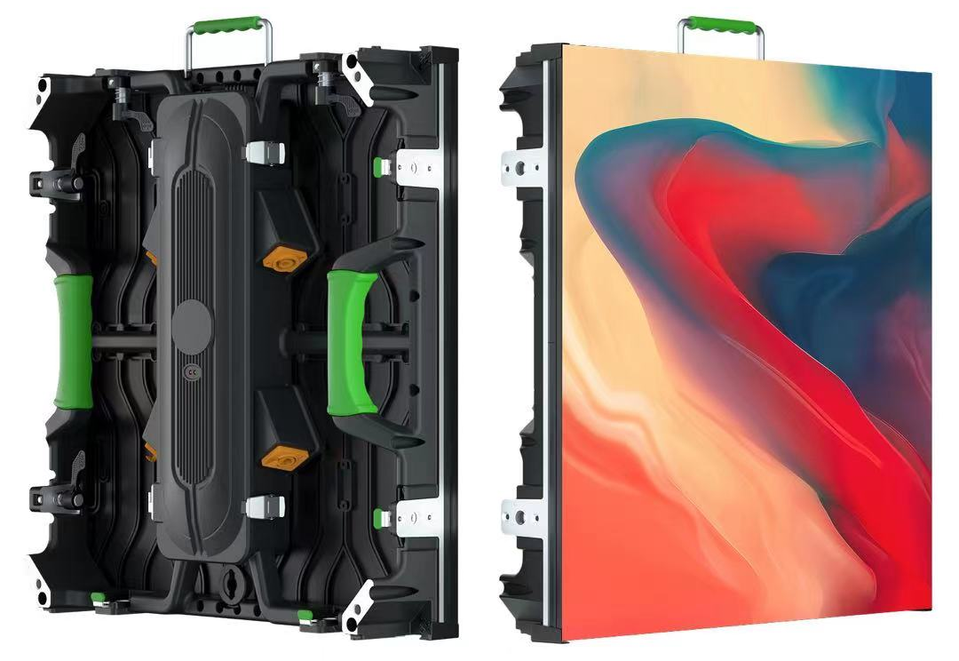
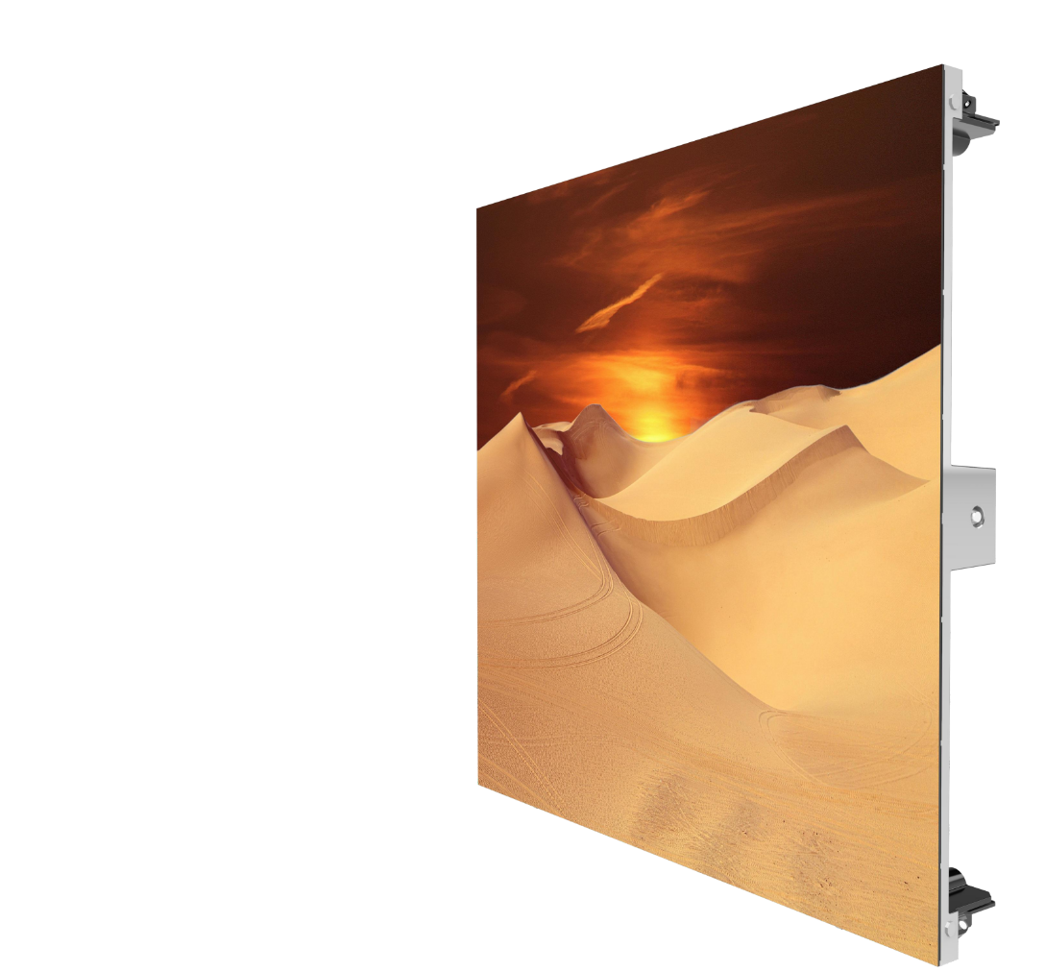
LSOF-E SERIES LED PANEL
LSOF2.9-E LSOF3.9-E LSOF4.8-E
DESIGNED FOR OUTDOOR FIXED APPLICATIONS
LSOF-E series LED panels are designed for outdoor rental / fixed applications,
PRODUCT IMAGE
FEATURES
cabinet size 500x500mm
Hight brightness,high contrast ratio
High refresh rate, no ghosting
Excellent visual quality, seamless alignment
Magnetic front service,front installation
Anti fire / corrosion
High contrast ratio > 5000:1
Customized PCB design for more reliable
STRUCTURE
Ground Structure Installation
Wall mounted
Stage design
www.leyard-linso.com

Slide 4
TECHNICAL PARAMETERS
Model name | LSOF2.9-E | LSOF3.9-E | LSOF4.8-E
Pixel Pitch (mm) | 2.976 | 3.906 | 4.81
Pixel Density (dot/m2) | 112896 | 65536 | 43264
Module Size (Wmm * Hmm*D) | 250*250*18 | 250*250*18 | 250*250*18
Module Resolution (PX* PX) | 84*84 | 64*64 | 52*52
Cabinet Size (Wmm * Hmm* Dmm) | 500*1000*75 | 500*1000*75 | 500*1000*75
Cabinet resolution | 168*336 | 128*256 | 104*208
Cabinet Weight (Kg) | 13kg/cabinet | 13kg/cabinet | 13kg/cabinet
Drive Mode: | 1/32 scan | 1/16 scan | 1/13 scan
Horizontal Viewing Angle (Deg) | 140 | 140 | 140
Vertical Viewing Angle (Deg) | 120 | 120 | 120
Brightness (cd/m2) | ≥3500 | ≥3500 | ≥3500
Contrast Ratio | 5000:1 | 5000:1 | 5000:1
Grey Scale（bit） | ≥14 | ≥14
Color temperature | 3000~10000K | 3000~10000K | 3000~10000K
Refresh Rate (Hz) | 3840 | 3840 | 3840
Max Power Dissipation(W/m²) | 800 | 800 | 800
Average Power consumption ((W/m²) | 280 | 280 | 280
IP rateing(F/R) | IP65/IP54 | IP65/IP54 | IP65/IP54
Input Voltage (V) | AC100~240V | AC100~240V | AC100~240V
Working Temperature (℃) | -20 ~ +40 | -20 ~ +40
Working Humidity（RH） | 10%~85% | 10%~85% | 10%~85%
Waterproof Level | IP65/IP54 | IP65/IP54 | IP65/IP54
working life | 100000H | 100000H | 100000H
Service access | Rear | Rear | Rear
Remark: Above data is subject to change without previous notice
Linso Culture & Technology (Shanghai) Co., Ltd
ADD:NO1259,Jiamei Road,Nanxiang Town,Jiading District,Shanghai,201802,China.
Tel:+86-21-69927037 Fax: +86-21-69927035
Email:sale@linso.com.cn
Website:www.leyard-linso.com

