Slide 1
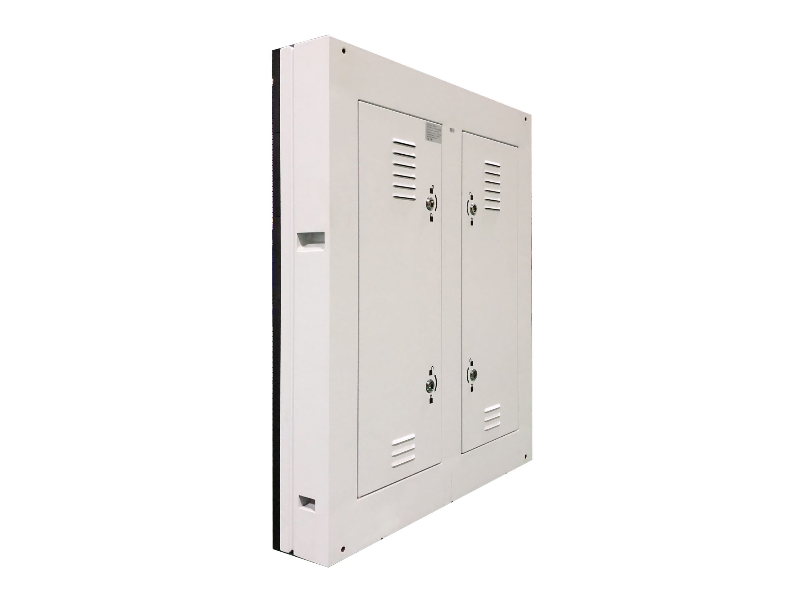
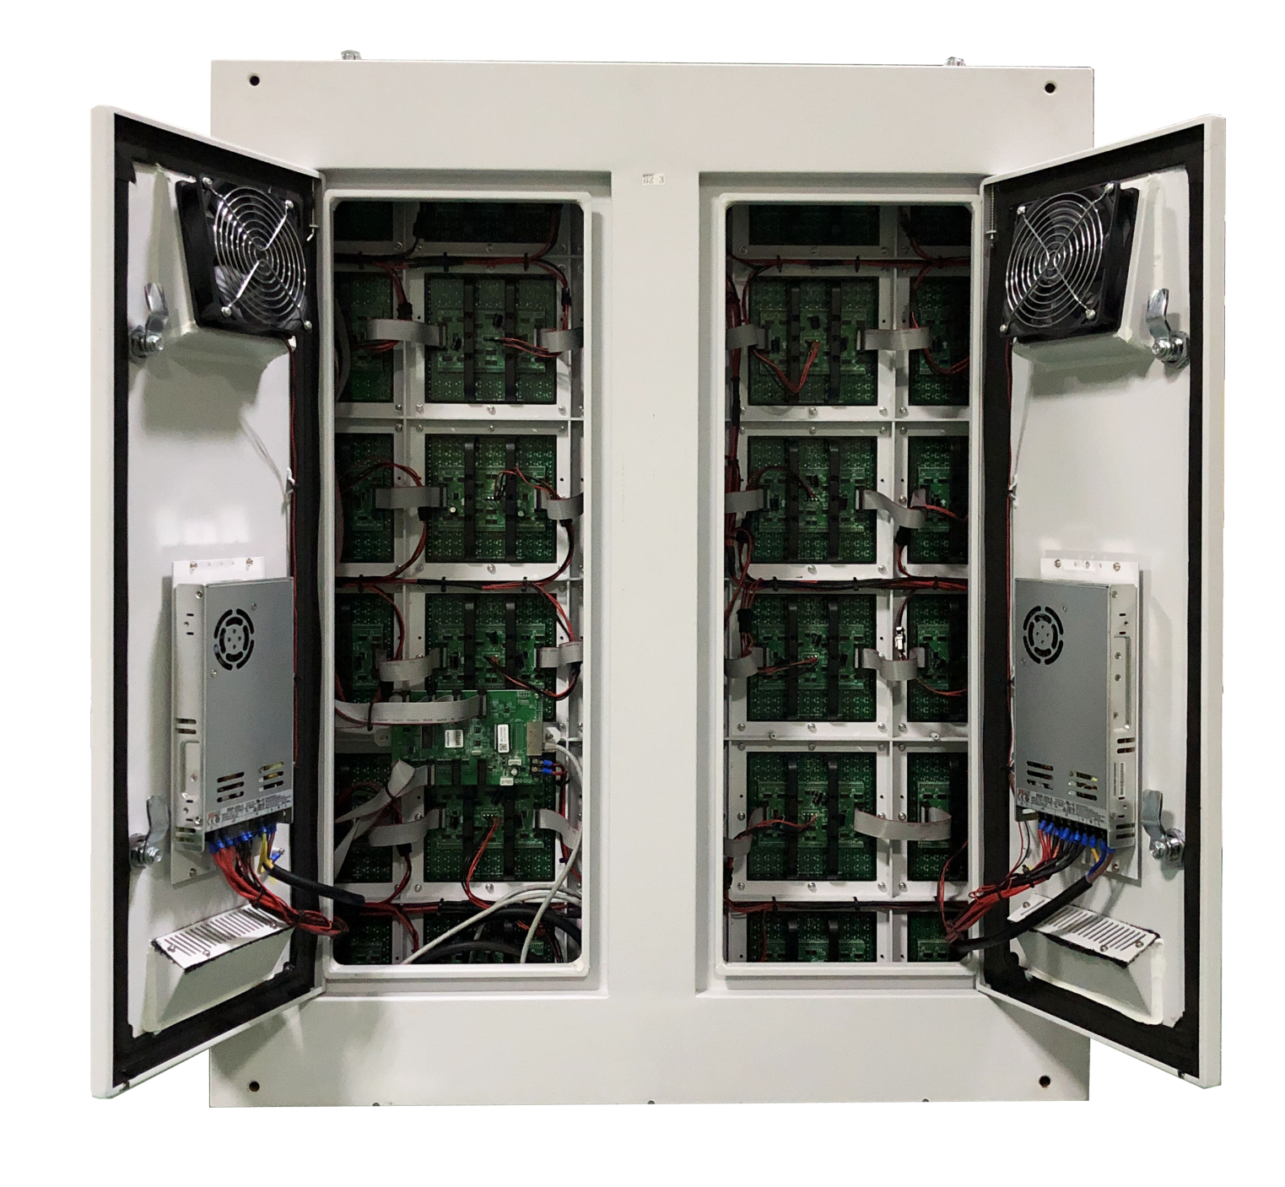
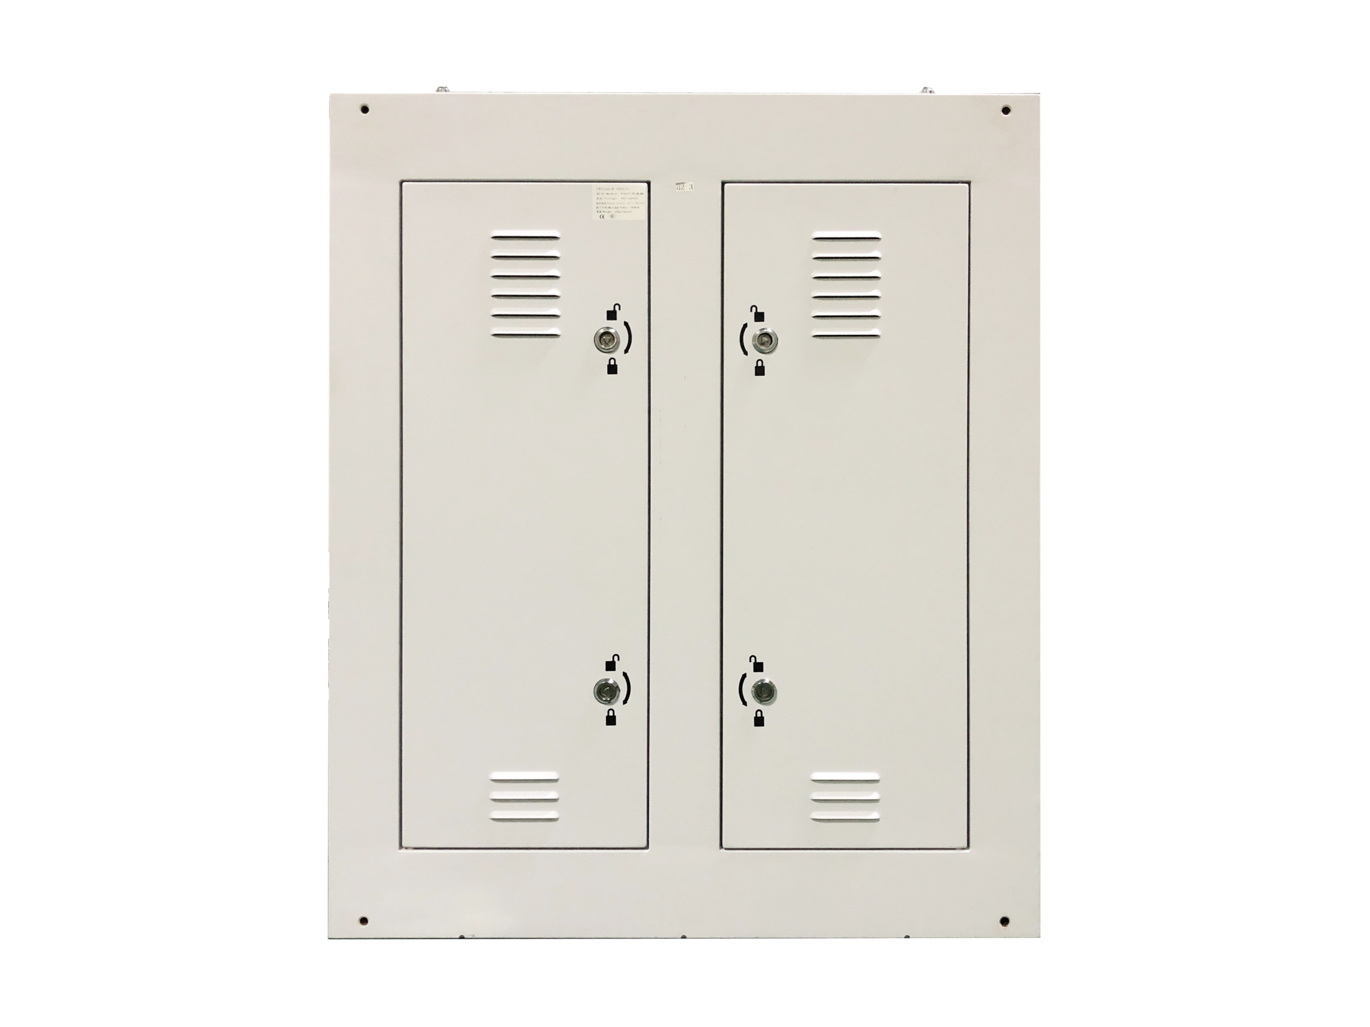
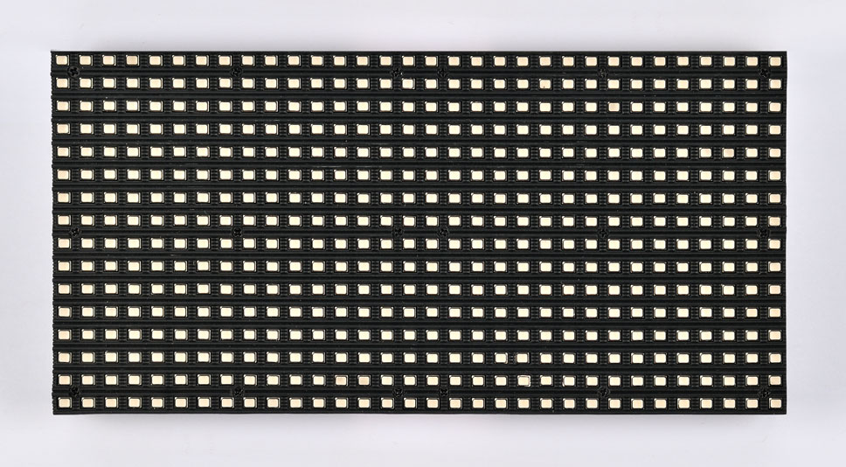
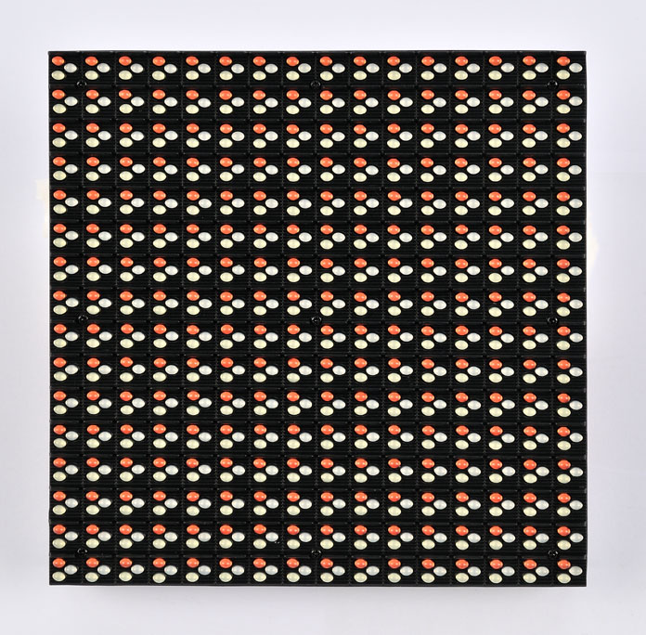
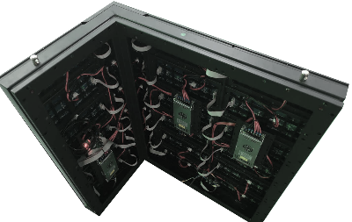
LSON SERIES LED PANEL
LSON2.5S LSON3S LSON4S LSON5S LSON6S LSON8S LSON10S
DESIGNED FOR OUTDOOR APPLICATIONS
LSON series LED panels are designed for outdoor regular/Irregular applications
PRODUCT IMAGE
FEATURES
Iron or aluminum cabinets are available
High temperature resistance <60℃ Max
IP65 for front side and IP54 for rear side
High brightness up to 7000cd/㎡
High contrast ratio > 4000:1
Customized shape is available(45°angle or ir-regular shape)
MODULE & CABINET DESIGN
SMD/DIP
Customized convex & 90 °cabinet
www.leyard-linso.com

Slide 2
TECHNICAL PARAMETERS
Item | LSON2.5S | LSON3S | LSON4S | LSON5S | LSON6S | LSON8S | LSON10S
Pixel | 2.5mm | 3.33mm | 4mm | 5mm | 6mm | 8mm | 10mm
Pixel Idensity/m² | 160000 | 90000 | 62500 | 40000 | 27777 | 15625 | 10000
Module size(mm) | 320*160 | 320*160 | 256*128 | 320*160 | 192*192 | 256*128 | 320*160
Cabinet size(mm) | 960*960 | 960*960 | 1024*1024 | 960*960 | 960*960 | 1024*1024 | 960*960
Material | Iron cabinet
Weight （KG/sqm） | 40
Gray level | 65536
Color process(Bit) | 14~16 bits
Refresh rate（Hz） | >3840 Hz
Drive mode/scan | 1/16 scan | 1/12 scan | 1/8 scan | 1/8 scan | 1/8 scan | 1/4 scan | 1/2 scan
Brightness（cd/m2） | >4500 | >5000 | >5000 | >5000 | >6000 | >5500 | >6000
Viewing angle H（°） | 140/120
Input Voltage（V） | AC110~240V
Input frequency（Hz） | 50/60Hz
Power consumption M （W/m²） | 880W | 880W | 950W | 900W | 750W | 750W | 750W
Power consumption A （W/m²） | 295W | 295W | 320W | 300W | 250W | 250W | 250W
Common cathode design options | NO | YES(700W max) | YES(600W max) | YES(600W max) | NO | NO | YES(500W max)
Working Temperature（ ℃） | -10℃~60℃
Working humidity(%) | 30%~85%
IP level(F/R) | IP65/IP54
Service method | Rear | Rear | Rear | Rear | Rear | Rear | Rear
Remark: Above data is subject to change without previous notice
Linso Culture & Technology (Shanghai) Co., Ltd
ADD:NO1259,Jiamei Road,Nanxiang Town,Jiading District,Shanghai,201802,China.
Tel:+86-21-69927037 Fax: +86-21-69927035
Email:sale@linso.com.cn
Website:www.leyard-linso.com

