Slide 1
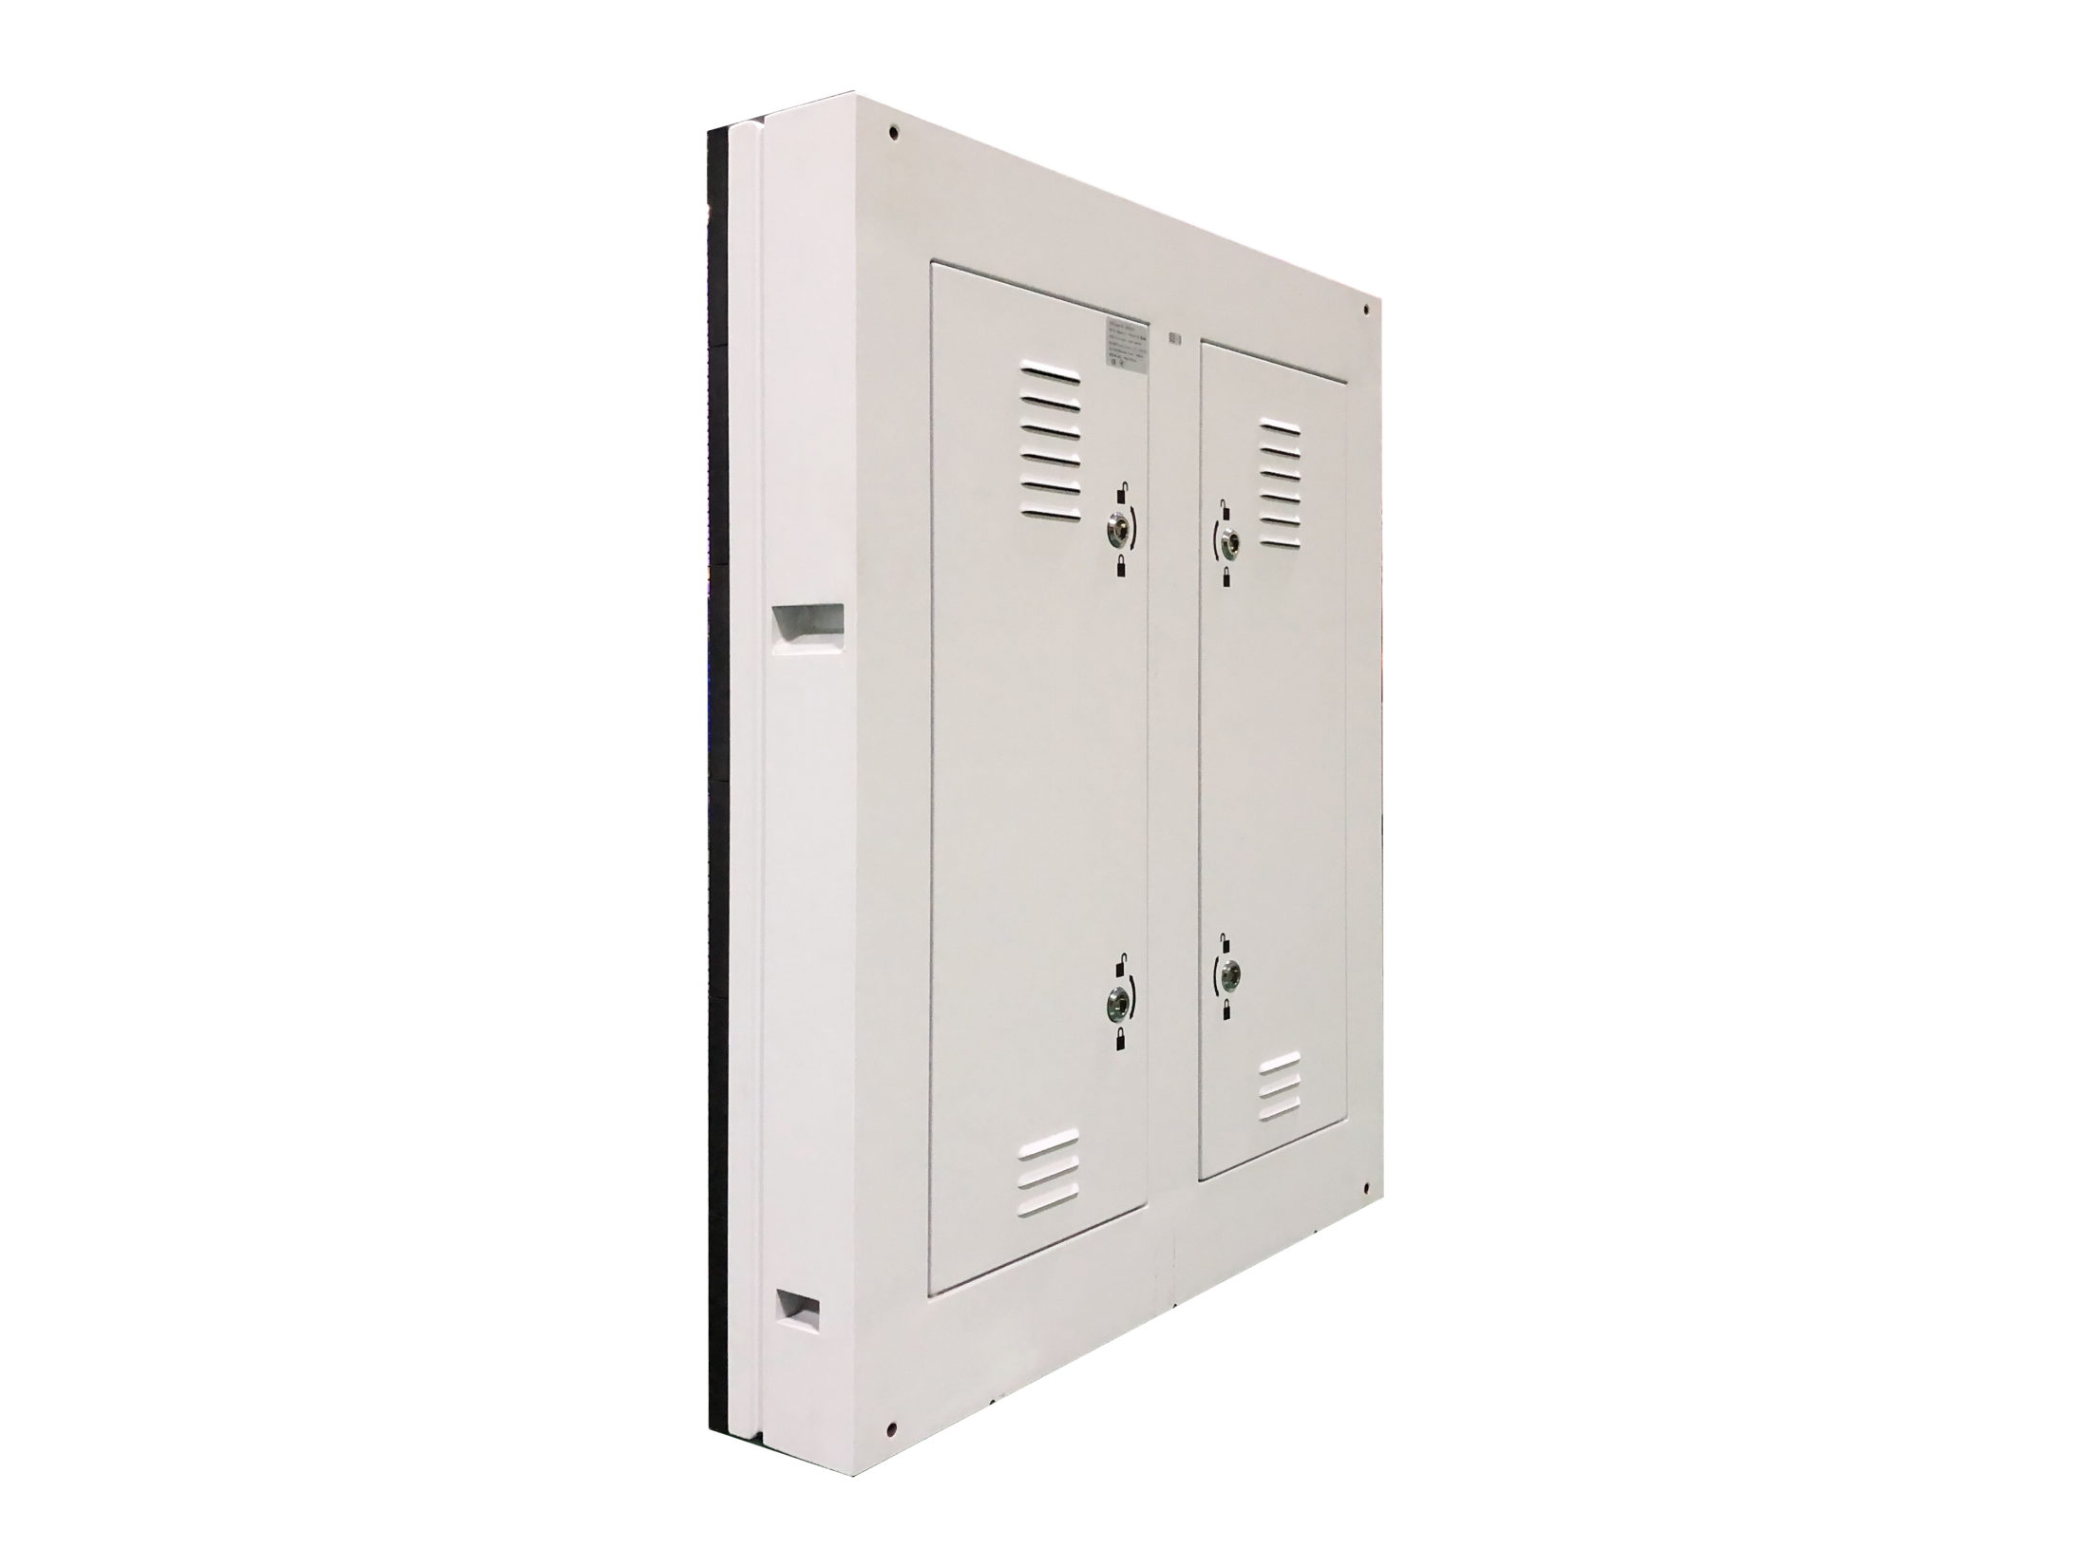
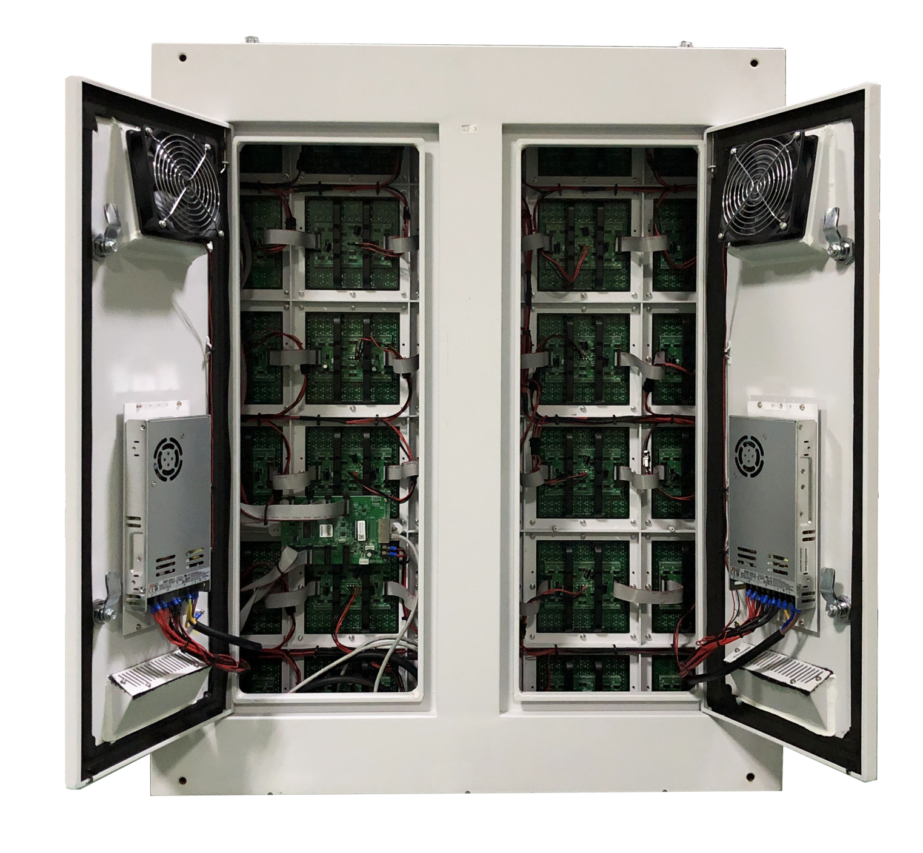
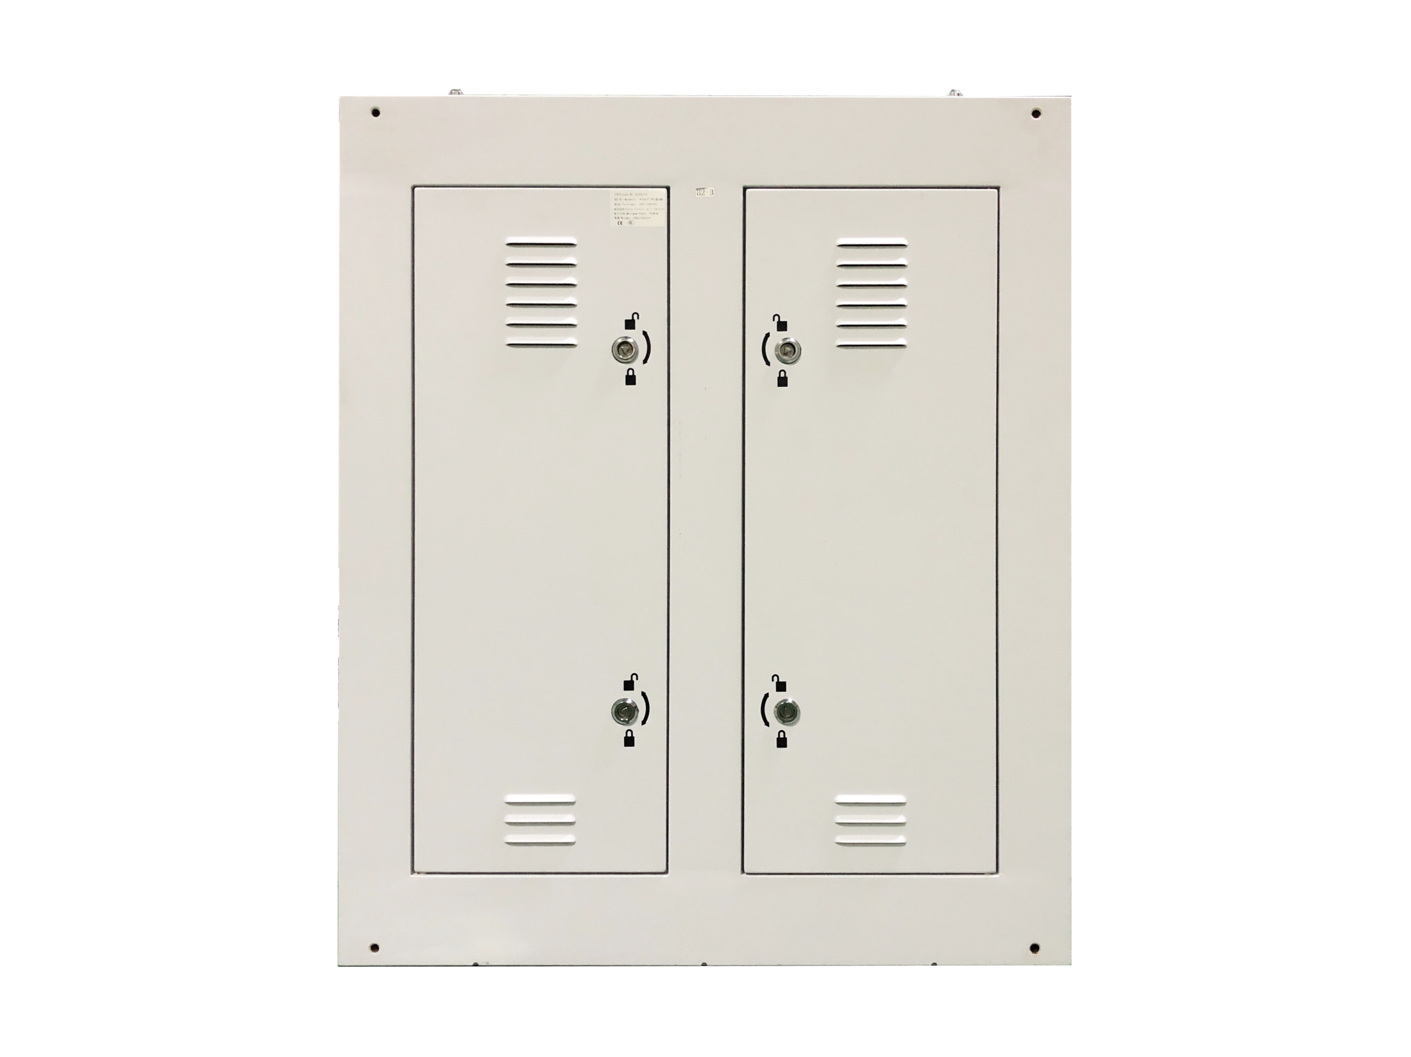
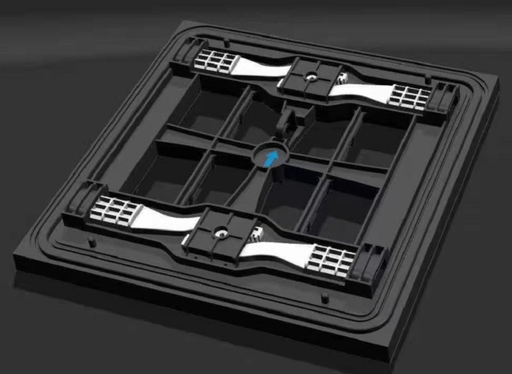
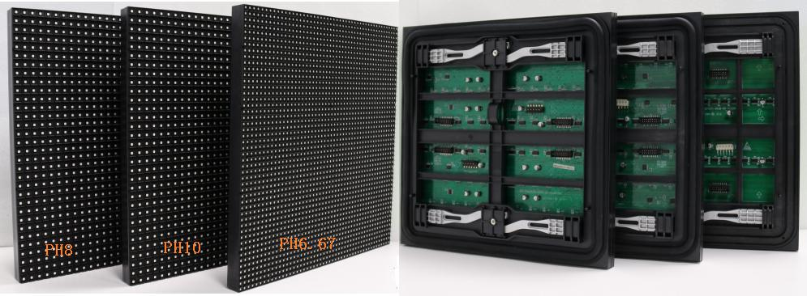
LSONF SERIES LED PANEL
LSON3.9F LSON4F LSON4.8F LSON6F LSON8F LSON10F
DESIGNED FOR OUTDOOR APPLICATIONS
LSON series LED panels are designed for outdoor regular applications
PRODUCT IMAGE
FEATURES
Iron or aluminum cabinets are available
High temperature resistance <60℃ Max
IP65 for front side and IP54 for rear side
Front service
High contrast ratio > 4000:1
MODULE DESIGN
www.leyard-linso.com

Slide 2
TECHNICAL PARAMETERS
Item | LSON3.9F | LSON4F | LON4.8F | LSON6F | LSON8F | LSON10F
Pixel | 3.9mm | 4mm | 4.8mm | 6.67mm | 8mm | 10mm
Pixel Idensity/m² | 65536 | 62500 | 43264 | 22500 | 15625 | 10000
Module size(mm) | 250*250 | 320*320 | 250*250 | 320*320
Cabinet size(mm) | 1000*1000 | 960*960 | 1000*1000 | 960*960 | 960*960 | 960*960
Material | Iron cabinet
Weight （KG/sqm） | 40
Gray level | 65536
Color process(Bit) | 14~16 bits
Refresh rate（Hz） | >3840 Hz
Drive mode/scan | 1/8 scan | 1/10 scan | 1/6 scan | 1/6 scan | 1/5 scan | 1/2 scan
Brightness（cd/m2） | 5000~5500 | 5000~5500 | 5000~5500 | 5500~6000 | 5500~6000
Viewing angle H（°） | 140/120
Input Voltage（V） | AC110~240V
Input frequency（Hz） | 50/60Hz
Power consumption M （W/m²） | 960W | 850W | 850W | 800W | 800W | 800W
Power consumption A （W/m²） | 320W | 280W | 280W | 260W | 260W | 260W
Common cathode design options | NO | NO | NO | YES(550W max) | YES(550W max) | YES(550W max)
Working Temperature（ ℃） | -10~60
Working humidity(%) | 30%~85%
IP level(F/R) | IP65/IP54
Service method | Front | Front | Front | Front | Front | Front
Remark: Above data is subject to change without previous notice
Linso Culture & Technology (Shanghai) Co., Ltd
ADD:NO1259,Jiamei Road,Nanxiang Town,Jiading District,Shanghai,201802,China.
Tel:+86-21-69927037 Fax: +86-21-69927035
Email:sale@linso.com.cn
Website:www.leyard-linso.com

