Slide 1
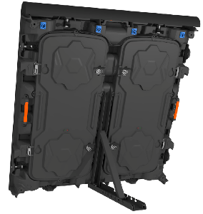
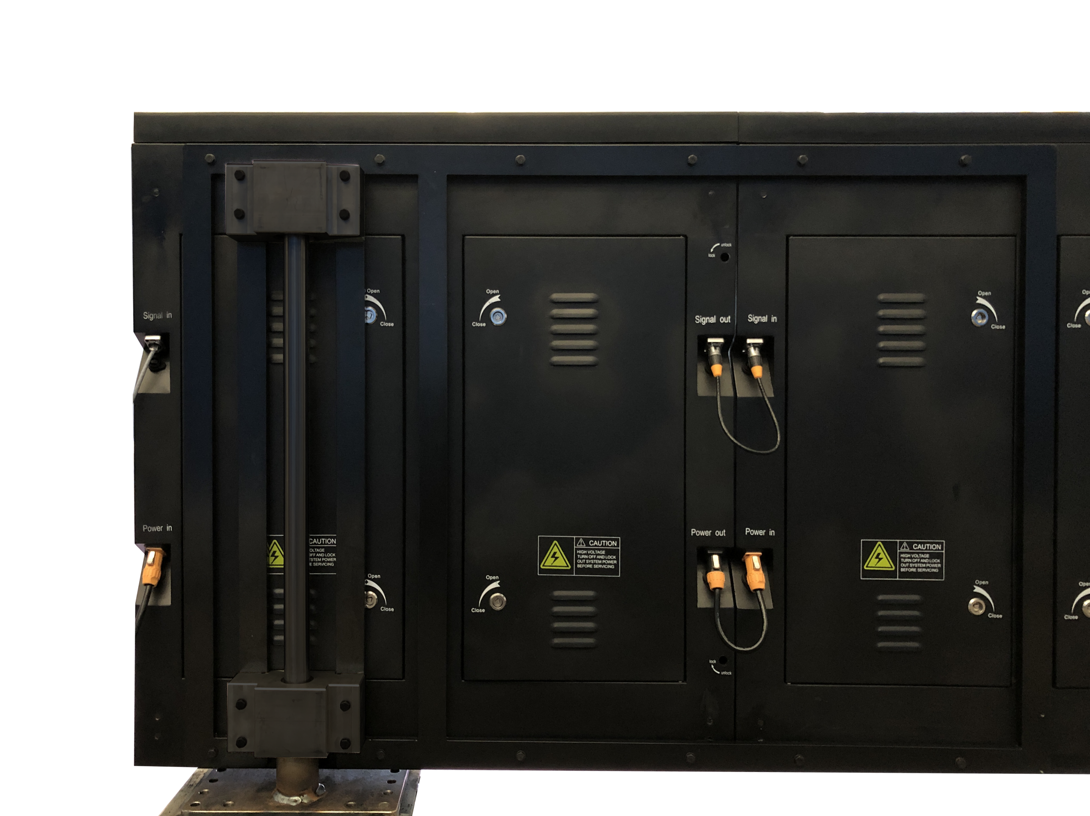
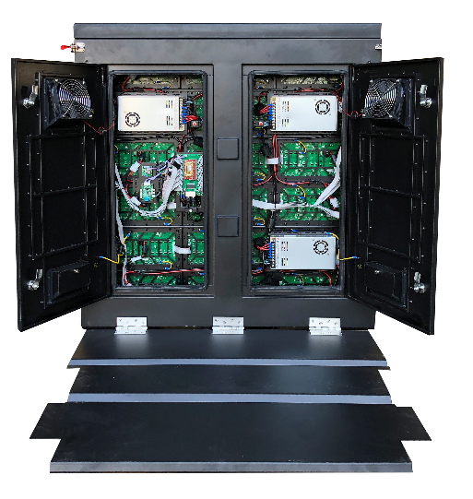
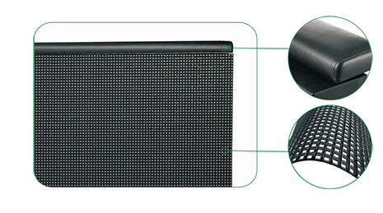
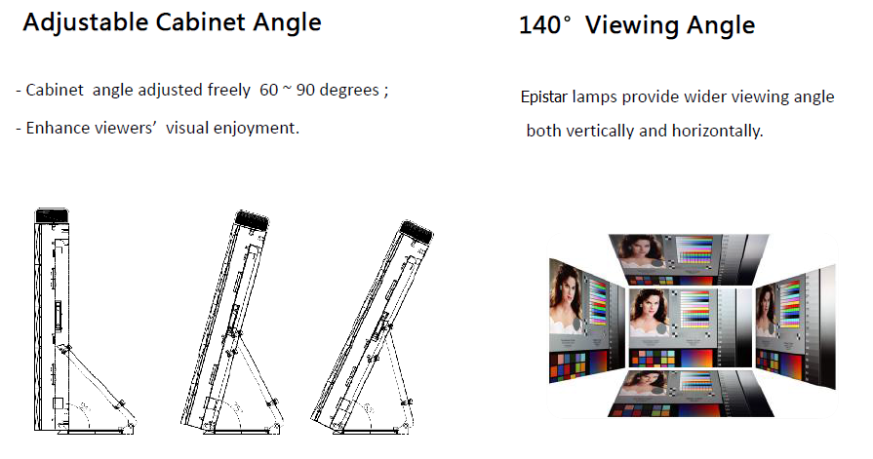
LSOS SERIES LED PANEL
LSOS8 LSOS10
DESIGNED FOR STADIUM
LSOS series LED panels are designed for sport events
PRODUCT IMAGE
FEATURES
960 x 960mm
Customized cabinet with rotating system
High contrast ratio, High refresh rate, no ghosting
High temperature resistance <60℃ Max
Anti-corrosion cushion rubber on top
Top cushion rubber & soft mask protects players & LED lamps
Perfect alignment no gaps with fast lock
Customized mechanical system for exit passageway
Wider viewing angle
CABINET DESIGN
Rubber mask that protects
LED lamps from striking by ball or player
www.leyard-linso.com

Slide 2
TECHNICAL PARAMETERS
Parameter | LSOS8 | LSOS10
Pixel Configuration | SMD 3 in 1 LED 3535 | SMD 3 in 1 LED3535
Pixel Pitch（mm） | 8 | 10
Module size(mm) （W×H×D） | 320x160 x18mm | 320x160 x18mm
Module resolution（W×H） | 40 X 20 | 32 X 16
Cabinet Size（mm）（W×H×D） | 960 X 960 X 100 | 960 X 960 X 100
Cabinet resolution（W×H） | 120 X 120 | 96 X 96
Cabinet area（m²） | 0.9216 | 0.9216
Weight（kg/sqm） | 45 | 45
Processing | 16 bit | 16 bit
Drive method | 1/4 scan | 1/2 scan
White Balance Brightness (nits) | ≥5000 | ≥5000
Viewing Angle（Horizontal/Vertical °） | 140/120 | 140/120
Contrast Ratio | 4000:1 | 4000:1
Max Power Consumption（W/m²） | 800W | 800W
Avg Power Consumption（W/m²） | 260W | 260W
Power Supply | AC220~240V/AC100-120V | AC220~240V/AC100-120V
Refresh Rate（Hz） | >3840 | >3840
Lifetime （hrs） | 100,000 | 100,000
Operation Temperature Range（℃） | -20 -- 60 | -20 -- 60
Operation Humidity Range（RH） | 10 -- 90% | 10 -- 90%
Service | R | R
Emergency design with rotating system | Optional | Optional
CE Certificate | Optional | Optional
Remark: Above data is subject to change without previous notice
Linso Culture & Technology (Shanghai) Co., Ltd
ADD:NO1259,Jiamei Road,Nanxiang Town,Jiading District,Shanghai,201802,China.
Tel:+86-21-69927037 Fax: +86-21-69927035
Email:sale@linso.com.cn
Website:www.leyard-linso.com

