Slide 1


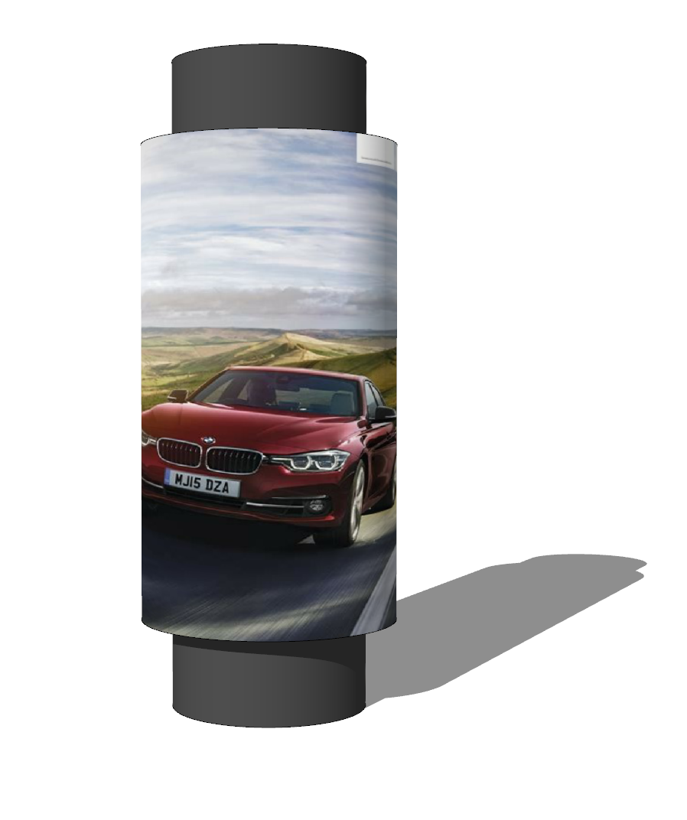
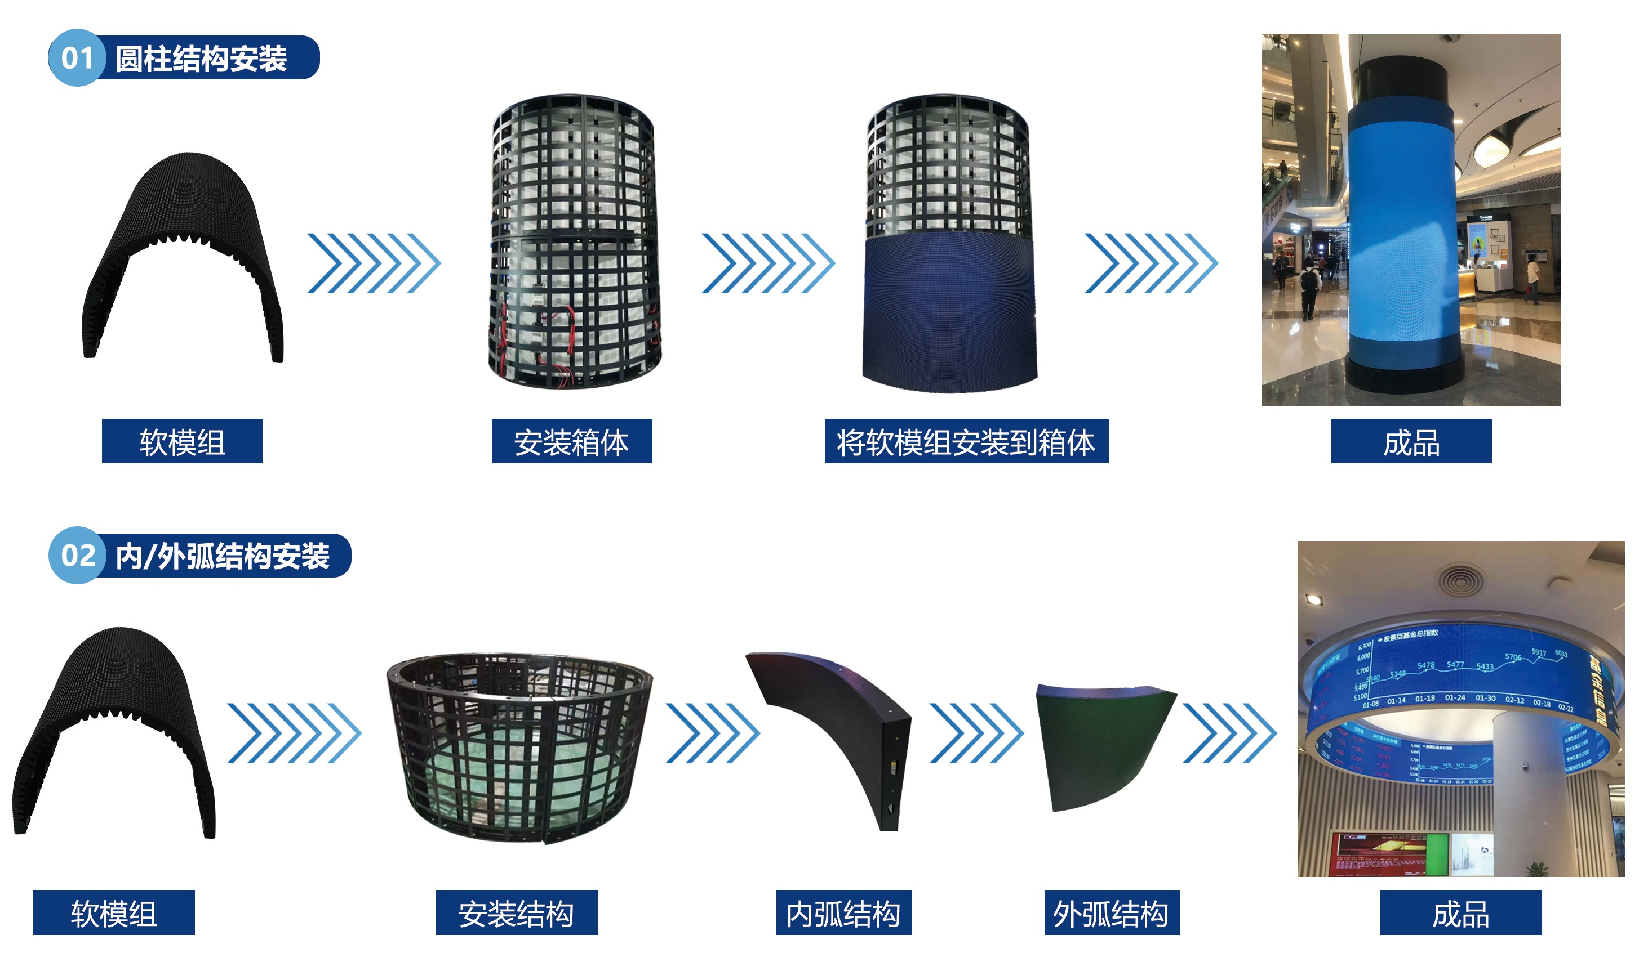
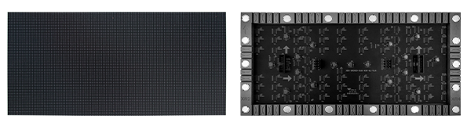
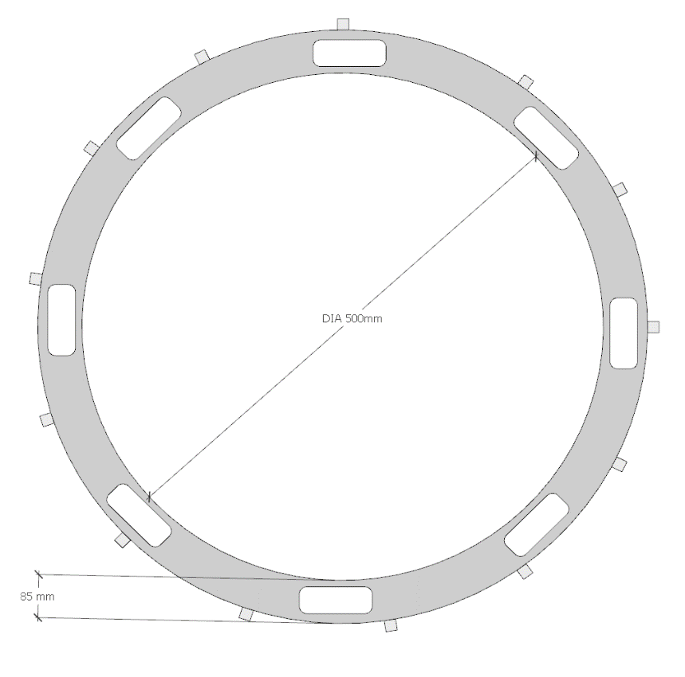
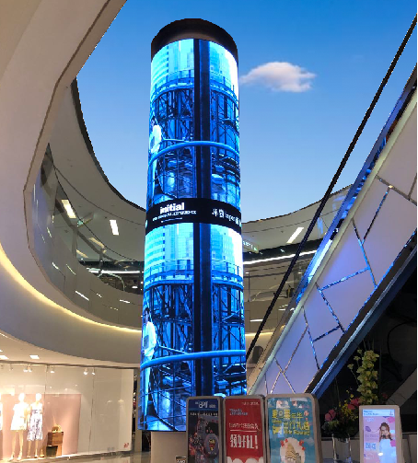
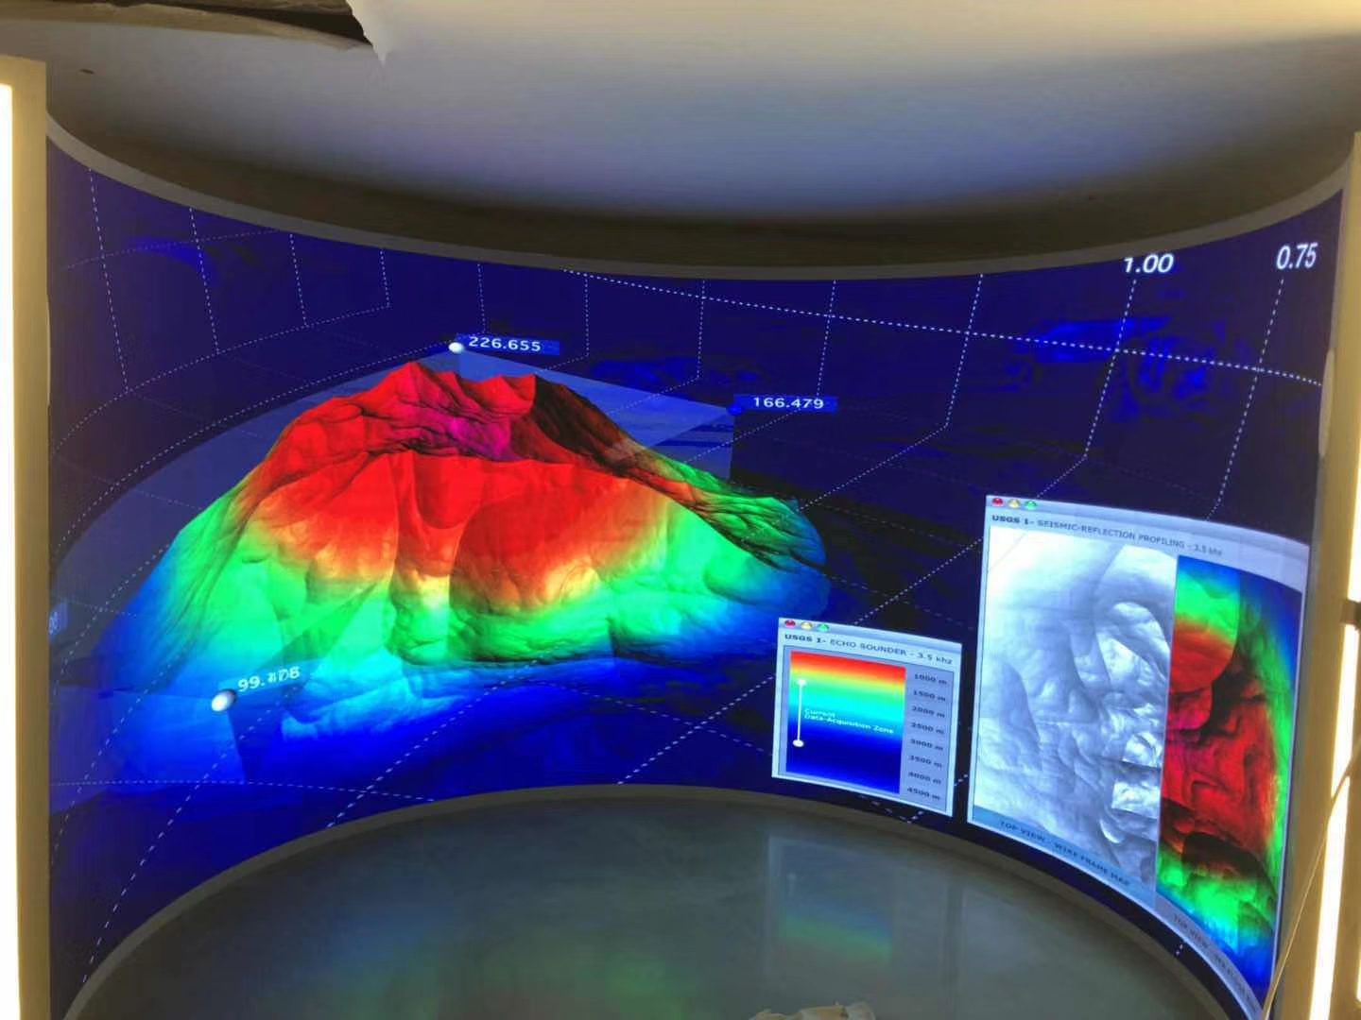
LSX SERIES LED PANEL
LSX1.28 LSX1.56 LSX1.66 LSX1.86 LSX2 LSX2.5 LSX3
DESIGNED FOR CYLINDER,CONVEX & CONCAVE APPLICATIONS
LSX series LED panels are more flexible and suitable for cylinder, convex & concave applications
APPLICATION
FEATURES
Black LED, high contrast ratio,High refresh rate, no ghosting
Silicone frame and customized PCB with bigger bended angle
Embedded 18 pcs strong magnets with better flatness
Perfect alignment no gaps & great flatness
Bigger viewing angle 160°/ 160°
Anti fire / corrosion material
Diameter ≥500mm
STRUCTURE
≥φ500mm
85mm
www.leyard-linso.com

Slide 2
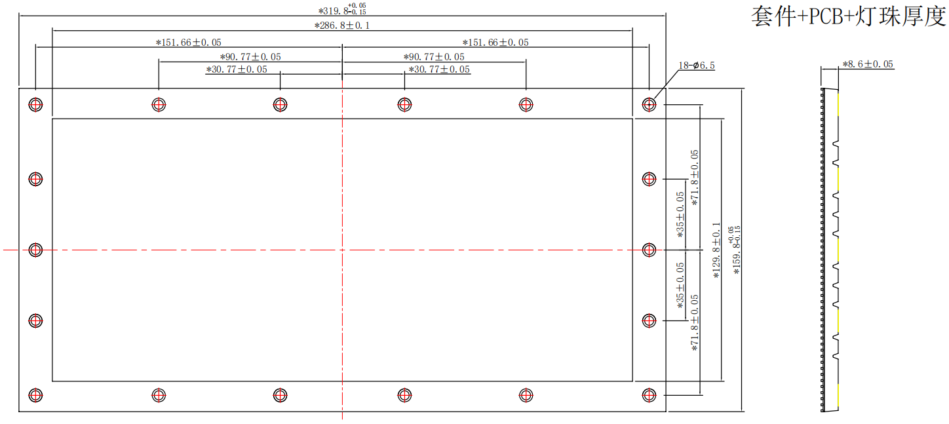
MODULE & CABINET DESIGN
Module size is 320x160mm with 18 pcs strong magnets,support front/back service
Convex design
Concave and convex design

Slide 3

TECHNICAL PARAMETERS
Model Name |  | LSX1.28 | LSX1.56 | LSX1.66 | LSX1.86 | LSX2 | LX2.5 | LSX3
Technical parameter | Pixel configuration | RGB 3 in 1
 | LED encapsulation | SMD1010 | SMD1212 | SMD1212 | SMD1515 | SMD1515 | SMD1515 | SMD1515
 | Pixel density（dots/m2） | 610351 | 406406 | 360000 | 288906 | 250000 | 160000 | 105625
 | Module size（mm） | 320x160x8.6mm
 | Module resolution | 250x125 | 204x102 | 192x96 | 172x86 | 160x80 | 128x64 | 104x52
 | Scan method | 1/63 | 1/51 | 1/48 | 1/43 | 1/40 | 1/32 | 1/26
 | Refresh rate（Hz） | ≥3000-3840
 | Frame Frequency（Hz） | 50&60
 | Gray scale（bit） | 12-16 adjustable
 | Module shell material | Silicone
 | Module weight（kg/pcs） | 0.334 | 0.325 | 0.318 | 0.315 | 0.315 | 0.269 | 0.252
 | Cabinet size | Customized according to module size
 | Cabinet materail | Iron
 | Cabinet flatness（mm） | ≤ 0.3
 | IP rating | IP40/IP30
 | Installation method | Front/rear
Optical parameter | Brightness（nits） | ≥650cd
 | Color temperature（K） | 3000—10000 adjustable
 | Brightness uniformity | ≥97%
 | Viewing angle | ≥160°/≥140°
 | Contrast ratio | 5000:1
Electric parameter | Module voltage DC（V） | 5 | 5 | 5 | 5 | 5 | 5 | 5
 | Module current DC（A） | 5 | 5 | 5 | 4.5 | 4.5 | 4.5 | 4.5
 | Module power consumotion max（w/pcs） | 25 | 25 | 25 | 22.5 | 22.5 | 22.5 | 22.5
 | Working voltage AC（V） | 110-220
 | Max power consumption（w/m2） | 600 | 600 | 600 | 600 | 600 | 600 | 600
 | Ave power consumption（w/m2） | 200 | 200 | 200 | 200 | 200 | 200 | 200
Operation parameter | Life（hrs） | 100,000
 | Working temperature（℃） | -10—50
 | Storage tem（℃） | -20—60
 | Working humidity（RH） | 20—85%
 | Storage humidity（RH） | 20—80%
Remark: Above data is subject to change without previous notice
Linso Culture & Technology (Shanghai) Co., Ltd
ADD:NO955,Jiamei Road,Nanxiang Town,Jiading District,Shanghai,201802,China.
Tel:+86-21-69927037 Fax: +86-21-69927035
Email:sale@linso.com.cn
Website:www.leyard-linso.com

